Slide 1
Professional Ethics and Responsibility for Records & Info Management Professionals
ARMA Charlotte NC, Oct 22, 2015
John C. Krysa, CRM, CIP
Principal Consultant, Millican & Associates

Slide 2
Agenda
Key Definitions
What’s a Profession?
Codes of Ethics
Formal Authorities
Challenges of determining legal or Illegal, ethical or unethical, right or wrong

Slide 3
Key Definitions
Law
Values
Fiduciary Responsibility
Code of Ethics
Leadership

Slide 4
Law
A system of rules and guidelines which are enforced through social institutions to govern behavior. (Wikipedia)
Laws are made by governments, specifically by their legislatures. The formation of laws themselves may be influenced by a constitution (written or unwritten) and the rights encoded therein.
Private individuals can create legally binding contracts, including (in some jurisdictions) arbitration agreements that exclude the normal court process.
The law shapes politics, economics and society in countless ways and serves as a social mediator of relations between people.

Slide 5
Values
Conceived of as guiding principles in life, which transcend specific situations, may change over time, guide selection of behaviour and events and which are part of a dynamic system with inherent contradictions. (Debats, D.L. & Bartelds, B.F)
In ethics, value denotes something's degree of importance, with the aim of determining what action or life is best to do or live (Deontology), or at least attempt to describe the value of different actions (Axiology). It may be described as treating actions themselves as abstract objects, putting value to them. It deals with right conduct and good life, in the sense that a highly, or at least relatively highly, valuable action may be regarded as ethically "good" (adjective sense), and an action of low, or at least relatively low, value may be regarded as "bad". (http://www.ask.com/wiki/Value_(ethics)?qsrc=3044)

Slide 6
Rokeach--Instrumental Values Instrumental Values refer to preferable modes of behavior, or means of achieving the terminal values.
1. Cheerfulness
2. Ambition
3. Love
4. Cleanliness
5. Self-Control
6. Capability
7. Courage
8. Politeness
9. Honesty
10. Imagination
11. Independence
12. Intellect
13. Broad-Mindedness
14. Logic
15. Obedience
16. Helpfulness
17. Responsibility
18. Forgiveness

Slide 7
Values--Milton Rokeach Terminal Values refer to desirable end-states of existence and goals to achieve during a lifetime.
1. True Friendship
2. Mature Love
3. Self-Respect
4. Happiness
5. Inner Harmony
6. Equality
7. Freedom
8. Pleasure
9. Social Recognition
10. Wisdom
11. Salvation
12. Family Security
13. National Security
14. A Sense of Accomplishment
15. A World of Beauty
16. A World at Peace
17. A Comfortable Life
18. An Exciting Life

Slide 8
Fiduciary Relationship
Relationship in which one party places special trust, confidence, and reliance in and is influenced by another who has a fiduciary duty to act for the benefit of the party (Lawyers.com)
In a fiduciary relationship, one person, in a position of vulnerability, justifiably vests confidence, good faith, reliance and trust in another whose aid, advice or protection is sought in some matter. In such a relation good conscience requires the fiduciary to act at all times for the sole benefit and interest of the one who trusts.(http://en.wikipedia.org/wiki/Fiduciary_relationship)

Slide 9
Professional Code of Ethics http://en.wikipedia.org/wiki/Code_of_Ethics#Code_of_practice_.28professional_ethics.29
A code of practice… adopted by a profession or by a governmental or non-governmental organization to regulate that profession.
may be styled as a code of professional responsibility, which will discuss difficult issues, difficult decisions
provide a clear account of what behavior is considered "ethical" or "correct" or "right" in the circumstances.
failure to comply with a code of practice can result in expulsion from the professional organization.
Based on values and principles, as opposed rules in a code of conduct for employees or organization members

Slide 10
Leadership
New Webster's lead definition: The position of office of a leader.
Leadership is the art of getting someone else to do something you want done because he wants to do it.
Dwight D. Eisenhower
Influencing people by providing purpose, direction, and motivation, while operating to accomplish the mission and improve the organization.
US Army AR 600-100, Mar 2007

Slide 11
Profession vs. Trade, Craft, Vocation
A profession arises when any trade or occupation transforms itself through "the development of formal qualifications based upon education, apprenticeship, and examinations, the emergence of regulatory bodies with powers to admit and discipline members, and some degree of monopoly rights. Practiced on the basis of relevant professional qualifications, in a personal, responsible and professionally independent capacity, by those providing intellectual and conceptual services, in the interest of the client and the public.
(http://en.wikipedia.org/wiki/Profession)

Slide 12
Major milestones which may mark an occupation being identified as a profession include: (http://en.wikipedia.org/wiki/Profession)
Becomes a full-time occupation
Establishment of a training school
Establishment of a university school
Establishment of a local association
Establishment of a national association
Introduction of codes of professional ethics
Establishment of state licensing laws

Slide 13
Institute of Certified Records Managers (http://www.icrm.org/about/code-of-ethics/)
CRM Certification Compels Adherence to Formal Code and Specified Standards
Defined Ethics Review Procedure
Controlled Certification Maintenance and Continued Professional Development
Periodic Decertification Actions
Certified Records Managers should maintain high professional standards of conduct in the performance of their duties. The Code of Ethics is provided as a guide to professional conduct.
Certified Records Managers have a professional responsibility to conduct themselves so that their good faith and integrity shall not be open to question. They will promote the highest possible records management standards.
Certified Records Managers shall conform to existing laws and regulations covering the creation, maintenance, and disposition of recorded information, and shall never knowingly be parties to any illegal or improper activities relative thereto.

Slide 14
ICRM Code of Ethics--Continued
Certified Records Managers shall be prudent in the use of information acquired in the course of their duties. They should protect confidential, proprietary and trade secret information obtained from others and use it only for the purposes approved by the party from whom it was obtained or for the benefit of that party, and not for the personal gain of anyone else.
Certified Records Managers shall not accept gifts or gratuities from clients, business associates, or suppliers as inducements to influence any procurements or decisions they may make.
Certified Records Managers shall use all reasonable care to obtain factual evidence to support their opinion.
Certified Records Managers shall strive for continuing proficiency and effectiveness in their profession and shall contribute to further research, development, and education. It is their professional responsibility to encourage those interested in records management and offer assistance whenever possible to those who enter the profession and to those already in the profession.

Slide 15
IGP Code of Ethics http://www.arma.org/r2/igp-certification/ethics
1. Demonstrate integrity, honesty and fairness.
2. Affirm the legal, ethical, and moral use of information.
3. Comply with applicable laws.
4. Protect the confidentiality of proprietary information.
5. Protect the privacy of individuals.
6. Report illegal or unethical practices.
7. Avoid compromise of professional judgment by conflicts of interest or the appearance thereof.

Slide 16
IGP Code of Ethics--Continued
8. Represent their qualifications and certifications truthfully and accurately.
9. Accurately represent the purposes of certification and associated competencies.
10. Maintain professional competence in all areas of responsibility and undertake assignments only when qualified by education and/or experience.
11. Accept responsibility for maintaining the credential through re-certification.
12. Use the IGP designation and property as authorized.
13. Uphold and abide by the policies of the IGP Certification Board.
14. Act in a manner free of bias with regard to religion, ethnicity, gender, age, national origin, or disability.
15. Issue public statements in an objective and truthful manner and only when founded upon knowledge of the facts and competence of subject matter.

Slide 17
An Ethical Opinion
The North Carolina Bar Association has drafted a proposed ethical opinion addressing lawyers’
use of software-as-a-service” (SaaS). The proposed opinion concludes that lawyers “may contract with a vendor of software as a service provided the risks that confidential client information may be disclosed or lost are effectively minimized.”
A 2d proposed opinion affirms the existence of best practices to be followed when contracting with a SaaS vendor “to minimize risk” and provides 23 questions a lawyer should be able to answer “satisfactorily in order to conclude that the risk has been minimized.” (http://www.arma.org/r1/news/newswire/2010/07/14/north-carolina-bar-proposes-considerations-for-use-of-saas)
Those questions include, but are not limited to:
• Whether the agreement with the vendor addresses confidentiality • How the data is protected • Who has access to the data • Who owns the data • How and when the data is backed up • What happens if the vendor goes out of business

Slide 18
IIT Center for the Study of Ethics in the Professions—Codes of Ethics Collection http://ethics.iit.edu/ecodes/ethics-area/7
Codes of Conduct for CPA and Auditing Firms
2007 International Good Practice Guidance, Defining and Developing an Effective Code of Conduct for Organizations, the International Federation of Accountants
"Principles, values, standards, or rules of behavior that guide the decisions, procedures and systems of an organization in a way that (a) contributes to the welfare of its key stakeholders, and (b) respects the rights of all constituents affected by its operations.“
American Library Association (Extract from 2008 Code)
We uphold the principles of intellectual freedom and resist all efforts to censor library resources.
We protect each library user's right to privacy and confidentiality with respect to information sought or received and resources consulted, borrowed, acquired or transmitted.

Slide 19
Selected Federal RIM Authorities
Generally Accepted Recordkeeping Principles® (http://www.arma.org/r2/generally-accepted-br-recordkeeping-principles)
Federal Records Act 44 USC, and 36 CFR
5 U.S.C. § 552 Freedom of Information Act
5 U.S.C. § 552a Privacy Act of 1974
18 U.S.C. § 2071) Concealment, Removal, or Mutilation of Records. Whoever willfully and unlawfully conceals, removes, mutilates, obliterates, or destroys, or attempts to do so, or, with intent to do so takes and carries away any record, proceeding, map, book, paper, document, or other thing, filed or deposited with any clerk or officer of any court of the United States, or in any public office, or with any judicial or public officer of the United States, shall be fined under this title or imprisoned not more than three years, or both.
18 USC § 1519 - Destruction, alteration, or falsification of records in Federal investigations and bankruptcy. Whoever knowingly alters, destroys, mutilates, conceals, covers up, falsifies, or makes a false entry in any record, document, or tangible object with the intent to impede, obstruct, or influence the investigation or proper administration of any matter within the jurisdiction of any department or agency of the United States, shall be fined under this title, imprisoned not more than 20 years, or both.
18 USC § 1520 - Destruction of corporate audit records. Fine, or imprisoned 10 years, or both.

Slide 20
Ethical Issues in the RIM profession
Whistle blowers act against their loyalty to the organization and sacrifice their careers to make a public disclosure.
When does an individual have an ethical obligation to do so?
Records professionals.
Privy to information that reveals wrongful acts and put in the classic position of the whistle blower.
Asked to falsify or destroy records,
Asked to improperly keep records on a subject or person
Asked share confidential or private information.
How to decide? What are alternatives?
http://content.arma.org/IMM/IMMJanuary-February2010/IMM0110inreviewtheethicsofrecordsmanagement.aspx

Slide 21
Krysa’s Opinion:
The RIM discipline ranges from entry level labor and support staff, through skilled and trained specialists, up to certified and independent professionals. LEADERSHIP is needed at all levels.
RIM related laws, rules and regulations apply to all, but must be written, interpreted, and assessed by RIM professionals.
Checklists, auditing, quality processes, and integrity & compliance programs are not substitutes for assessments and judgments rendered by credentialed RIM professionals.
Knowing and applying “the Principles” and ICRM Code of Ethics are essential for ultimate personal and organizational success.

Slide 22
Questions and Comments?

Slide 23
Some Topics of Interest
FBI Records Management Challenges:
Different Requirements: Evidence, Investigative Case Files, Intelligence
Different Media: Old and new, paper and digital, planned and unplanned
Different Access and Sharing Requirements: Complex Security
9/11 Attack on the Pentagon

Slide 24
Pentagon

Slide 25
Morning of Sept 11, 2001

Slide 27
Site of attack

Slide 28
Extent of Penetration by AA#77

Slide 29
Sept 12, 2001 Fires are contained and work resumes.

Slide 30
New and Old Construction

Slide 31
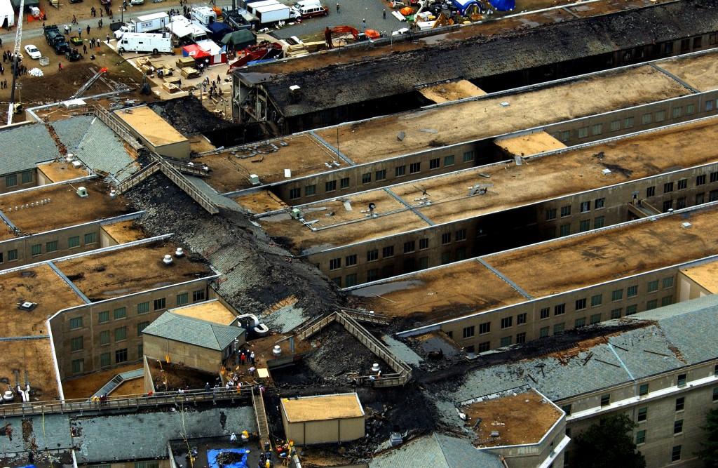
Sept 14, 2001 Fires Out

Slide 32
Pentagon Reconstruction

Slide 33
Construction Complete

