Slide 1
E-Discovery, Destruction Considerations and Legal Holds
Mark Henriques
Partner
Womble Carlyle Sandridge & Rice, LLP

Slide 2
Overview
Records Retention and Destruction
Litigation Holds
Implementation
Management
Sanctions
Role of E-Discovery Counsel & ECA

Slide 3
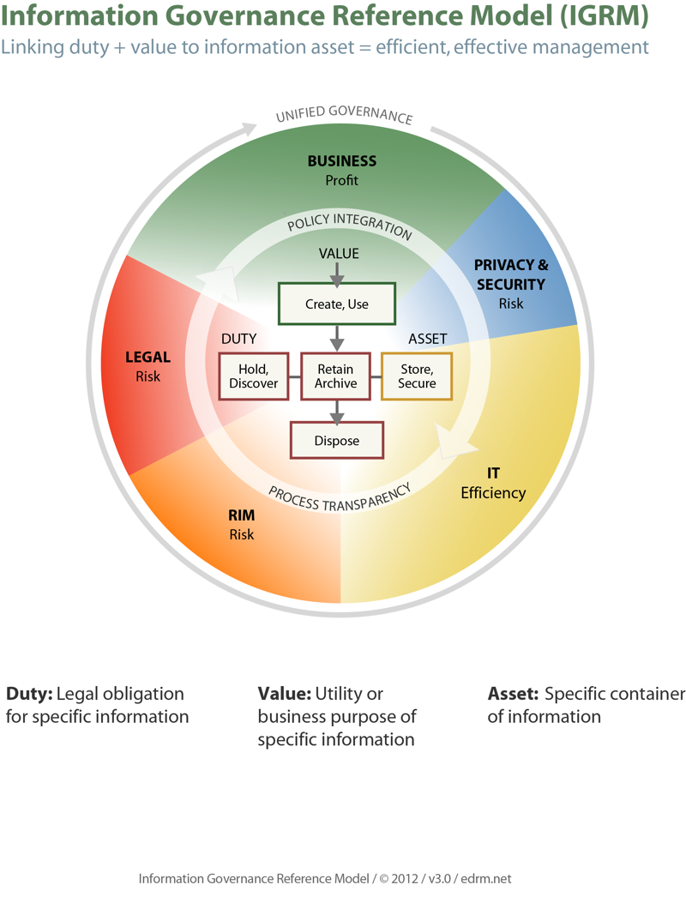

Slide 4
Document Retention & Legal Holds
Duty to preserve arises when you reasonably anticipate litigation (e.g. discrimination claim, letter from attorney, etc).
Absent claim, business reasons and compliance laws dictate what is retained.

Slide 5
Who implements a legal hold?
1. In-House Counsel
2. Outside Counsel
3. Vendors

Slide 6
When is Litigation “Reasonably Foreseeable?”
Formal Complaint is made or filed.
Incident or Dispute arises.
Regulatory or governmental Agency Investigates/Audits entity.
Discovery Request sent by third party.
Legal Hold/Document Preservation Request initiated.

Slide 7
How is the hold implemented?

Slide 8
Litigation Off Switch
Immediately stop
deletion of
email and other
electronic documents

Slide 9
Identify the KEY PLAYERS. . . We’re meeting with them on Day 1!
The Litigation Hold begins with their e-mail, documents and data.

Slide 10
Custodian Interviews
Ask what relevant documents they have?
How are the documents maintained?
Who is IT representative that can describe system security and processes?
Where are the documents stored? – Go over possible storage locations (If have completed a document flow chart with IT use it)
Any other custodians? (Who else has data?)

Slide 11
Legal Hold Notice
Should come from senior official (General Counsel is a good choice).
Define document broadly – Make sure everyone understands include electronic documents.
List what categories of documents should be retained.
Include time frame of documents to be retained.
Include who to call with questions.

Slide 12
Legal Hold – Administrative Issues
Often good to ask each person who else in the company might have responsive documents (and then add them to your hold).
Good practice to have each person sign hold to acknowledge received and have complied (of course you must follow up to get all back).
Send periodic Hold reminders to custodians.
Track Holds electronically, if possible.

Slide 13
Legal Hold - IT Issues
Establish identity of 30(b)(6) - IT staff member.
Consult with IT staff (preferable in advance of needing/issuing litigation hold).
Establish technical parameters of hold, i.e.:
Stop auto deletion
Secure files
Notify IT of all custodians and supplement as more custodians are identified

Slide 14
What about Personal Devices
Almost everyone has some BYOD issues.
Litigation increasingly involves these devices:
Percentage of companies which had to preserve/collect data from an employee’s mobile device continues to increase.
Best practice to include BYOD/Data on Mobile Device in Litigation Hold Notice.

Slide 15
E-Mail in Litigation Holds
Decide how to handle email – Best solution is often to have IT handle rather than individual user. If your company uses automatic deletion, dangerous to have custodians have responsibility to keep.
If individuals users, need to be sure keep in native format (e.g. not print out).
Another solution is to have users put emails in a secure location (server/drive).

Slide 16
Texts, Instant Messaging, Social Media
Need to consider text message
Does your company use IM/OM?
What about calendar entries?
What about to do lists/task lists?
What about voicemails?
What about social media?– Do you need to preserve company Facebook page, etc.?

Slide 17
Managing Litigation Holds
Must be documented
Need a tracking tool
Outside counsel can help manage / maintain privilege / advise on hold
Send Reminders – Every 6-12 months so employees do not forget about hold
Have a process to address documents when an employee leaves

Slide 18
When Litigation Resolved
Be sure to lift hold when litigation is resolved.
Can be tricky if multiple litigation holds (with possibly overlapping information) in place.
Some eDiscovery platforms address this issue with multiple, overlapping ESI folder systems.

Slide 19
Where do we look for guidance?
Sedona Conference
Judge Scheindlin’s Zubulake opinions
Advisory Committee Report
Recent Case Law / Reporters

Slide 20
Is the Data Accessible?
Judge Scheindlin’s Hierarchy
Most to Lease Accessible
Active, on-line data
Near on-line data
Offline storage / archives
Back-up Tapes / Disaster Recovery
Erased, fragmented or damaged data

Slide 21
Sanctions
Most Commonly Sanctioned Behavior:
Destruction of evidence (84%)
Delayed production (16%)
Most Common Sanction:
Attorney’s fees and costs are the most commonly
granted sanction (60%)
Evidentiary preclusion (30%)
Adverse inference instructions (23%)
Dismissal or default (23%)

Slide 22
Recent Decisions
Selective preservation warrants adverse inference. Calderon v. Corporacion Puerorique a de Salud (D.P.R. 2014)
Adverse inference and monetary sanctions for failure to issue litigation hold or monitor preservation efforts. Zest IP Holdings, LLC v. Implant Direct Mfg. (S.D.Cal. 2013)

Slide 23
Recent Decisions
Litigation hold triggered by patent evaluation. Lending Tree v. NexTag (W.D.N.C. 2014)
Must show missing evidence was relevant to litigation for sanctions. Automated Solutions v. Paragon (6th Cir. 2014)
E-Discovery dispute should not be used as a tactic. Procaps S.A. v. Patheon, Inc. (S.D.Fl. 2014)

Slide 24
Litigation Hold Management System
The Sedona Conference’s Commentary on Legal Holds: The Triger and the Process emphasizes that litigation hold policies and practices should be tailored to a client’s individual needs.
The guidelines are not intended and should not be used as a “checklist” or set of rules that are followed mechanically. Instead, they should guide entities in articulating a policy for implementing legal holds that is tailored to their individual needs.”
www.thesedonaconference.org

Slide 25
OLD CORPORATE LITIGATION MODEL
Outside Law Firms
Corporate General Counsel
14

Slide 26
OLD CORPORATE LITIGATION MODEL
(with E-Discovery)
E-Discovery Component
Outside Law Firms
Corporate General Counsel
E-Discovery Component
15

Slide 27
NEW CORPORATE LITIGATION MODEL
Outside Law Firms: Trial Counsel
Corporate General Counsel
E-Discovery consolidated with e-Discovery counsel
E-Discovery Counsel
16

Slide 28
E-Discovery Counsel Benefits
Systems Mapping
Data Preservation
Discovery about ESI
Rule 26(f) Conference
Data Collection
Early Processing
Search/Data Analytics
Privilege Management
Process Audit Capability
▲▲▲
▲▲
▲▲
▲▲
▲
▲
▲
▲
▲▲
17

Slide 29
Early Case Assessment
Quick determination of key claims, issues, players and sources of documents
Identify, preserve and collect ESI related to claim
Use Technology Assisted Review (TAR) to quickly identify most of the key documents
Option of written, privileged claim assessment

Slide 30
CONCLUSION
Most cases now involve e-discovery
Almost all newly created information is stored electronically
Expensive and time consuming, but potential source of key discovery
Electronic documents constantly changing – may want to image to preserve now

Slide 31
RESOURCES
Sample Retention Policies
Sample Litigation Hold Notice
Purging the Cloud: Data Destruction in the Age of Cloud Computing (Henriques, 2014)
“Taking Control of Discovery and Review Costs in the Era of Big Data” - Oct 30 2013, ACC Annual Meeting Los Angeles, CA
Case Law(Zubulake, Automated Solutions, Calderon, Procaps, Zest)
Sedona Commentary of Information Governance (2013)
https://thesedonaconference.org/download-pub/3421
Sedona Glossary of E-Discovery and Digital Information Management (2014)
https://thesedonaconference.org/download-pub/3757

Slide 32
Mark P. Henriques
Womble Carlyle Sandridge & Rice, LLP
3500 One Wells Fargo Center
301 S. College Street
Charlotte, NC 28202
(704) 331-4912
Mhenriques@wcsr.com

