Slide 1


reliability
ARMA Charlotte Piedmont
Getting in the Weeds to Successfully Achieve your Goals
February 2020
People. Partnership. Performance.
Notes:
YOU WILL ROCK THIS! ☺

Slide 2
How many of you made a New Year’s Resolution for 2020?
Specific
Measurable
Attainable
Relevant
Timely

Slide 3
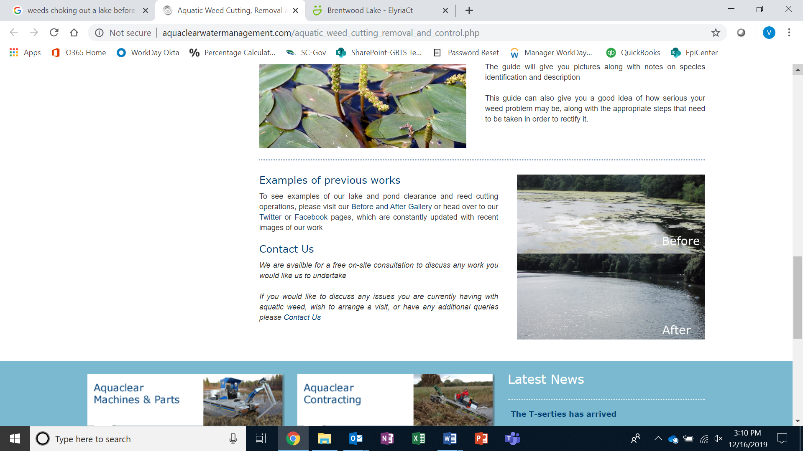
Getting in the Weeds!

Slide 4
Clear the Path
1. Get in the Weeds = Process Mine
2. Communicate the Benefit
3. Use Your Existing Resources

Slide 5
about Epiq
We are a worldwide provider of legal services, serving law firms, corporations, financial institutions and government agencies—helping them streamline the administration of business operations, class action and mass tort, court reporting, eDiscovery, regulatory, compliance, restructuring, and bankruptcy matters.
what is global business transformation solutions?
Epiq’s Global Business Transformation Solutions(GBTS) provides exceptional business process outsourcing and consulting services to law firms, corporations and government entities around the globe.
We help our clients focus on their core competencies by bringing efficiency, consistency and continual improvement to the critical functions that support and drive their business.
We achieve this through a strategic combination of onsite and offsite services with unparalleled subject matter experts & technology-enabled solutions for a variety of business needs.
People. Partnership. Performance. epiqglobal.com

Slide 6
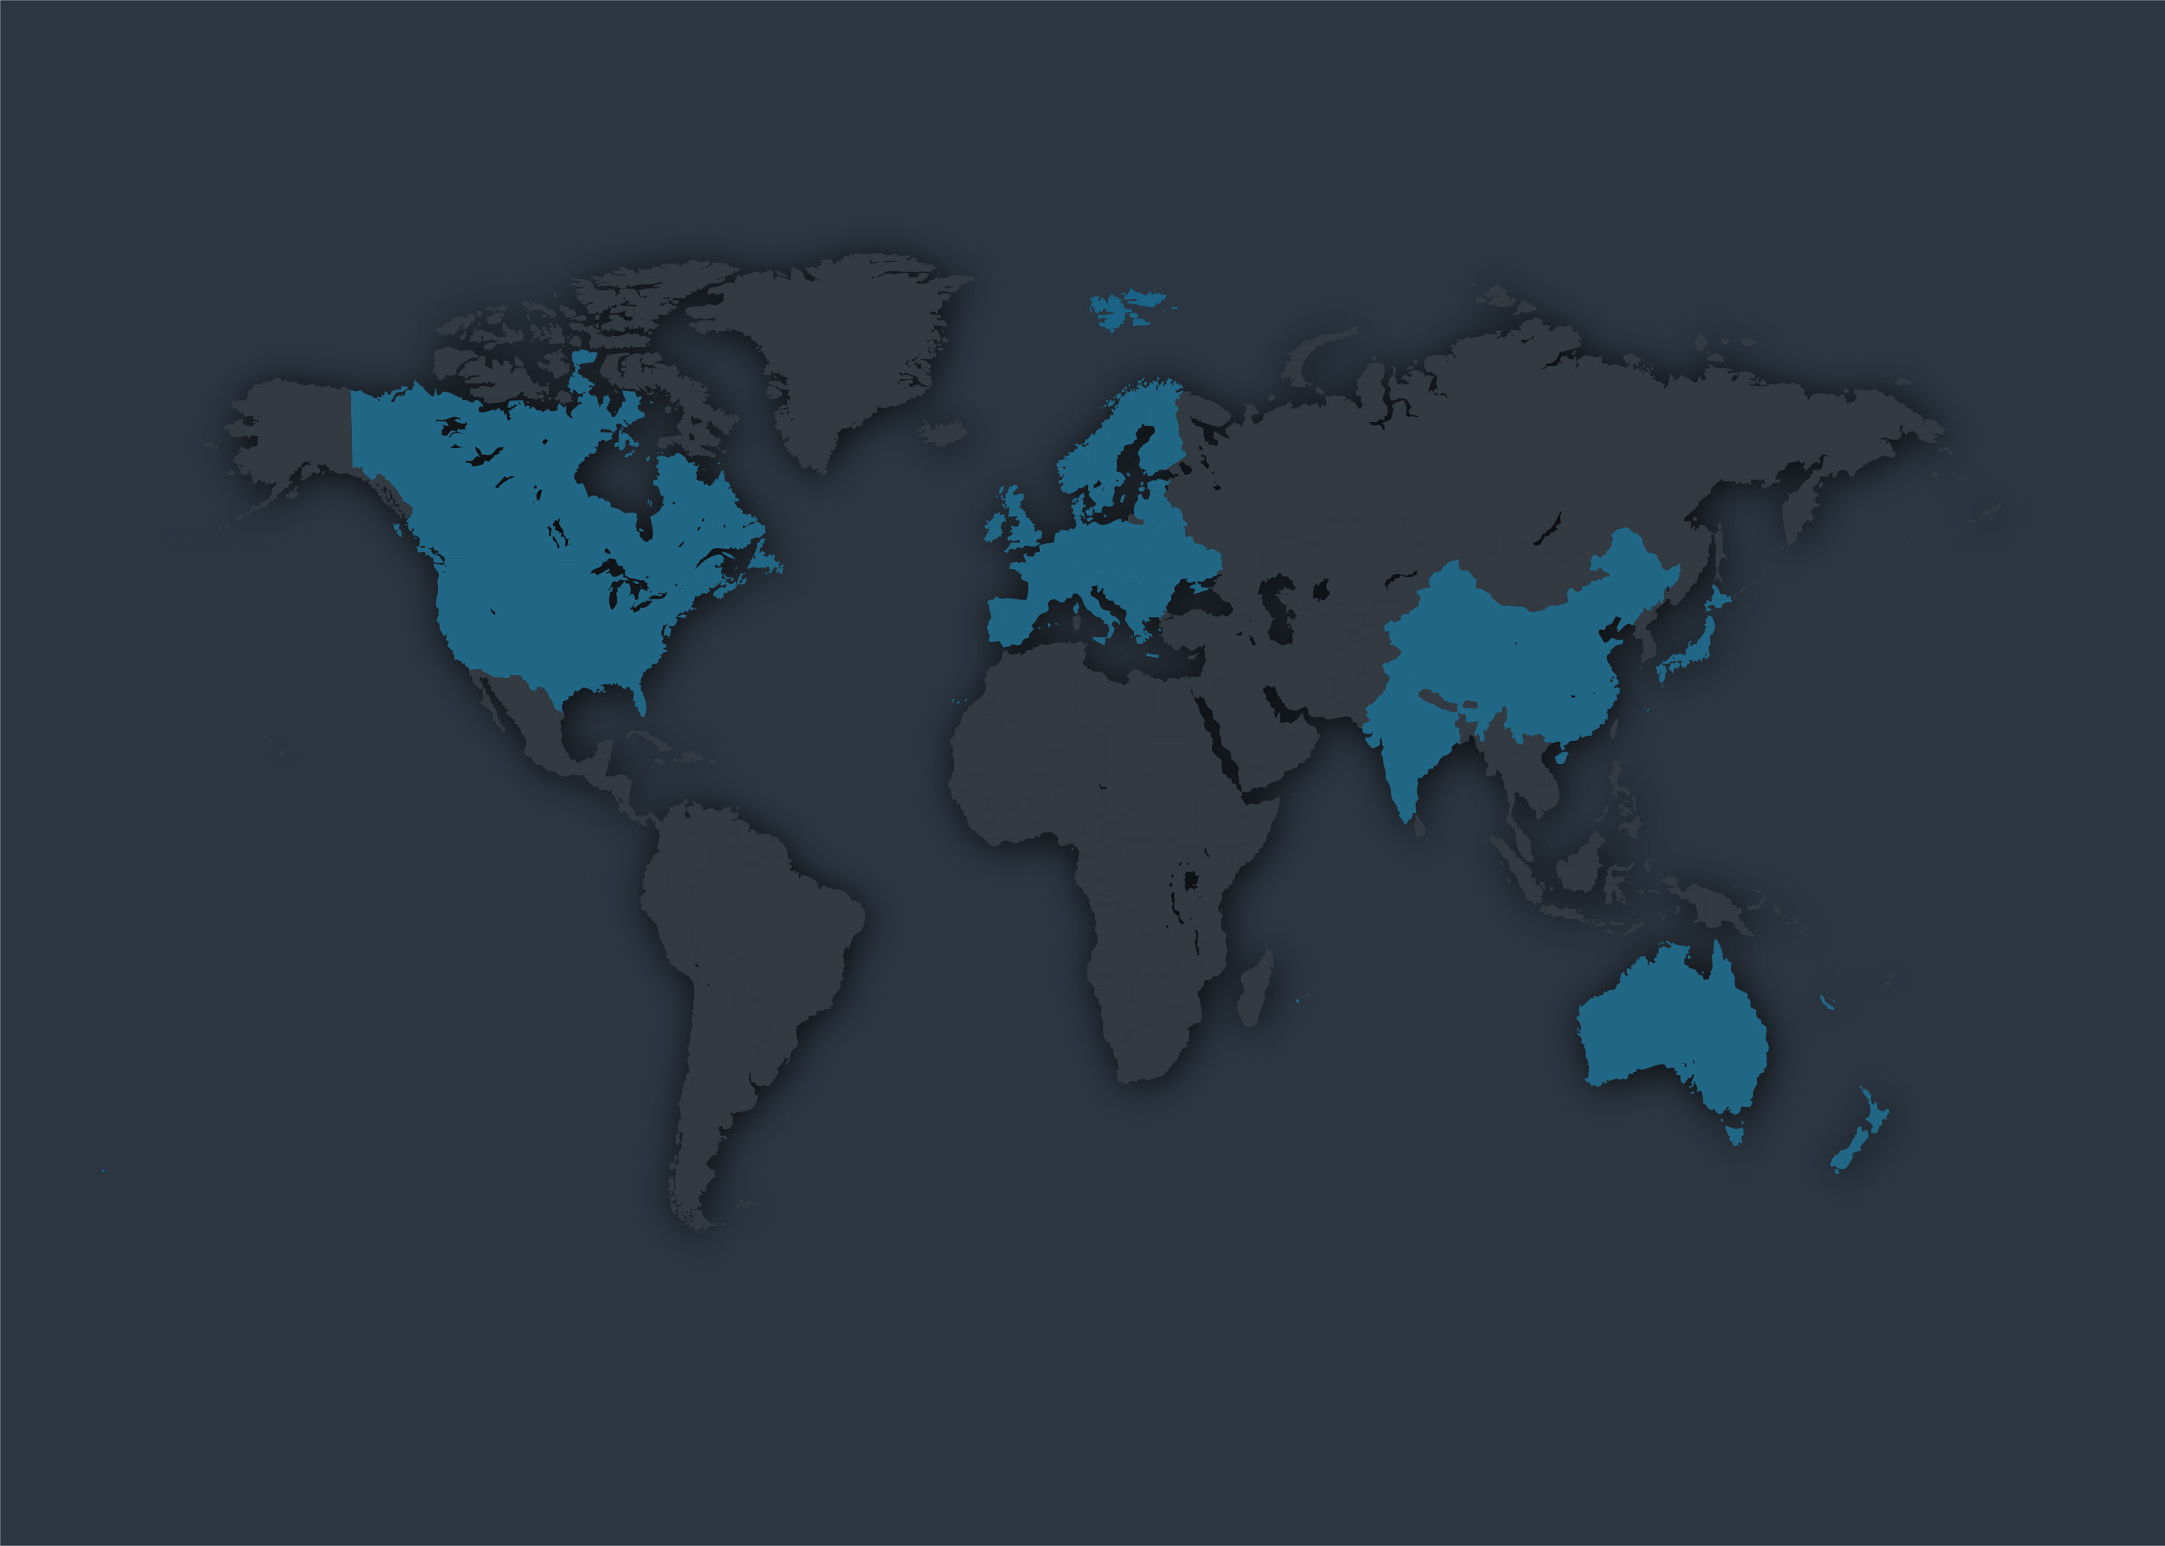
global business transformation solutions
size and scope
Am Law 150
27% of top 150 are Epiq clients
>500
onsite client operations
80+
Epiq offices around the world
> 7,000
employees globally
50+
clients serviced via captive centers
> 24
US domestic national accounts
2,350+
business transformation solution employees
66%
of our Am Law 150 clients are global
6

Slide 7

Scan, Print, and Copy
Contract & NDA
Management
Hospitality
Litigation
Support
Document Processing
all-in-one
integrated global business transformation solutions
Mail Services
Receptionist
Managed
Print Services
Marketing & Creative
IT & AV Support
Administrative
Supply Management
Information Governance
Consulting
Services
Records Management
Risk and Research Services
7

Slide 8

business trends: what GBTS and our clients are experiencing today
Client-Facing
Billing compression Multi-generational workforce Reduction in real estate Redefining support roles Continued focus on InfoSec & privacy laws Less paper-digitization Competition from Big Four
Marketplace
Many competitors focused on equipment contracts Emphasis on RIM and Middle Office (administrative) Competitors submitting unsolicited proposals Technology becoming key differentiator Rising minimum wages Organizations reducing headcount by outsourcing non core functions
8
People. Partnership. Performance. epiqglobal.com

Slide 9
epiq capabilities
People
Transition of responsibility
Flexibility/scalability
Training/development & career paths
Process and best practices
Best practices and thought leadership
Audits, ongoing evaluations/bench marks
Project management, expertise
Accountability and control
Allows firm to focus on “core”
vs. “non-core”
Management business reviews – monthly, quarterly, annually
Service level agreements (SLAs)
Access to subject matter experts (SMEs)
Informal/formal surveys of satisfaction
Invoices – pass thru options
for clients
9

Slide 10
epiq approach
Management
Support/
SME
Utilization
Consistent
Service
Analysis for
Efficiencies
Recruiting
Partnership
Meetings
Metrics
Process Improvement
Training
10
People. Partnership. Performance. epiqglobal.com

Slide 11
an insider’s guide to outsourced advantages
Whether you use our mail, office, duplication, and equipment services, or our middle office support, you can rely on our Epiq quality advantages at every step of the way.
talent
experienced and highly trained personnel in each client location
accountability
a single point of contact to simplify and ensure oversight of all services and drive innovation and cost savings year-over-year
consistency
technology enabled reporting and operating procedures allow for consistent service levels and response times
ideas
proactive tools, resources, and recommendations based on best practices to leverage technology and streamline processes
innovation
innovative solutions that optimize processes and employee utilization resulting in forward thinking service delivery.
11

Slide 12
increased investment in SMEs, resources, training & support
7
why
epiq?
national, global leadership structure and epiq vision
commitment to ongoing flexibility, scalability aligned with organizatinal goals
build on technology-savvy, workforce for the future
12
People. Partnership. Performance. epiqglobal.com

