Slide 1
ARMA Charlotte-Piedmont
November 15, 2018

Slide 2
ARMA International & Information Coalition
ARMA International: the world’s leading membership organization serving the professionals who manage and govern information assets, providing best practices, standards, and education.
The Information Coalition: focused on high-level information strategy and developed best practices around how companies both leverage and protect organizational information.
Together: a solitary voice providing a unified, consistent, and authoritative message to serve the information community as a whole.

Slide 3
The Information Governance Body of Knowledge (IGBOK)
Provides clear, concise, and practical guidance, along with useful tools to govern your information assets effectively.
Through strategic advice, policy guidance, “how to” processes, and valuable templates, it can be used to:
•Develop a plan to gather support for implementing an IG program
•Provide the framework for developing and maintaining an IG program
•Facilitate collaboration among IG stakeholders
•Educate staff about their information-handling responsibilities
•Further readers’ knowledge and skills in support of their professional development goals
FREE WITH YOUR ARMA INTERNATIONAL MEMBERSHIP!

Slide 4
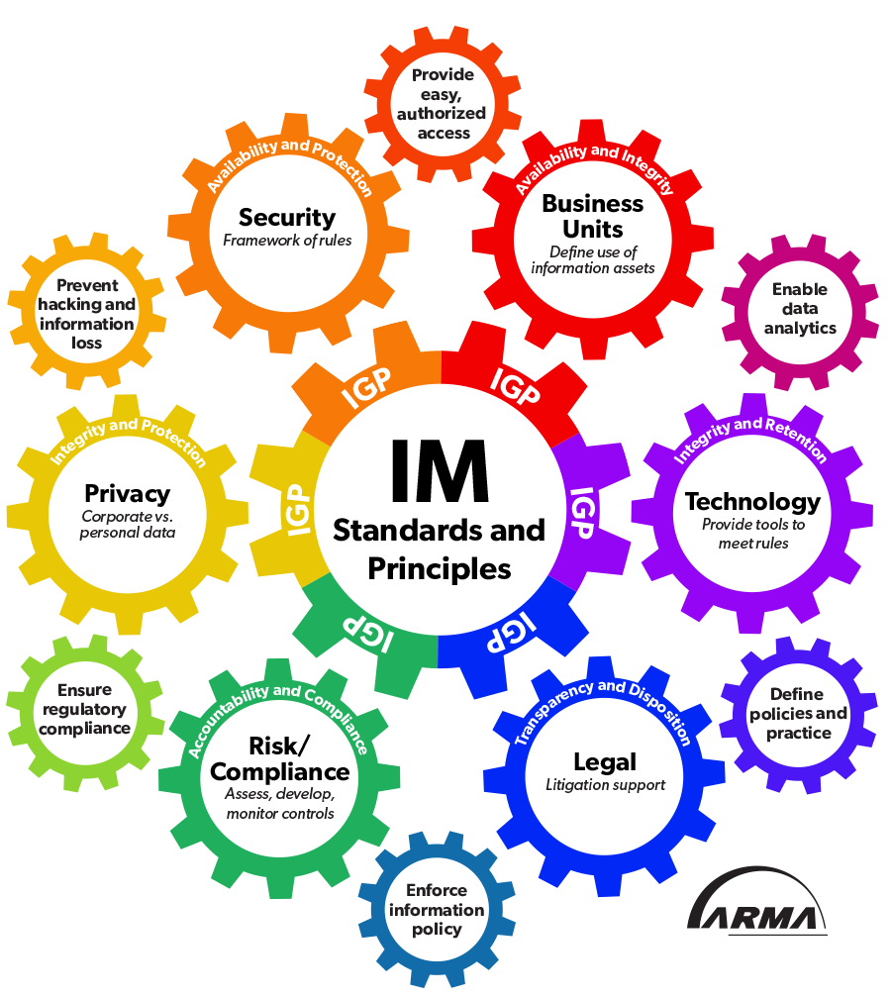
ARMA’s New Information Governance Industry Core Concepts Graphic

Slide 5
Membership Benefits
More than 200 free web seminars
More than 250 free job aids
Discounted fees for online courses and certificates
Discounted fee for ARMA Live!, the profession’s premier annual conference
Free virtual conference registration
Free iMasters interactive sessions, live and on demand
Free ARMA inDepth newsletter – a deep-dive into hot topics and industry pain points
Free Information Management magazine
Regular updates on industry news and trends
Mentorship program and student programs
ARMA International Virtual Conference
Four highly-rated education sessions
Virtual exhibition hall
Live text-chat with subject matter experts
Tuesday, December 11, 2018
Free for professional members
Must register in advance
Up to 4 hours of IGP or ICRM credits

Slide 6
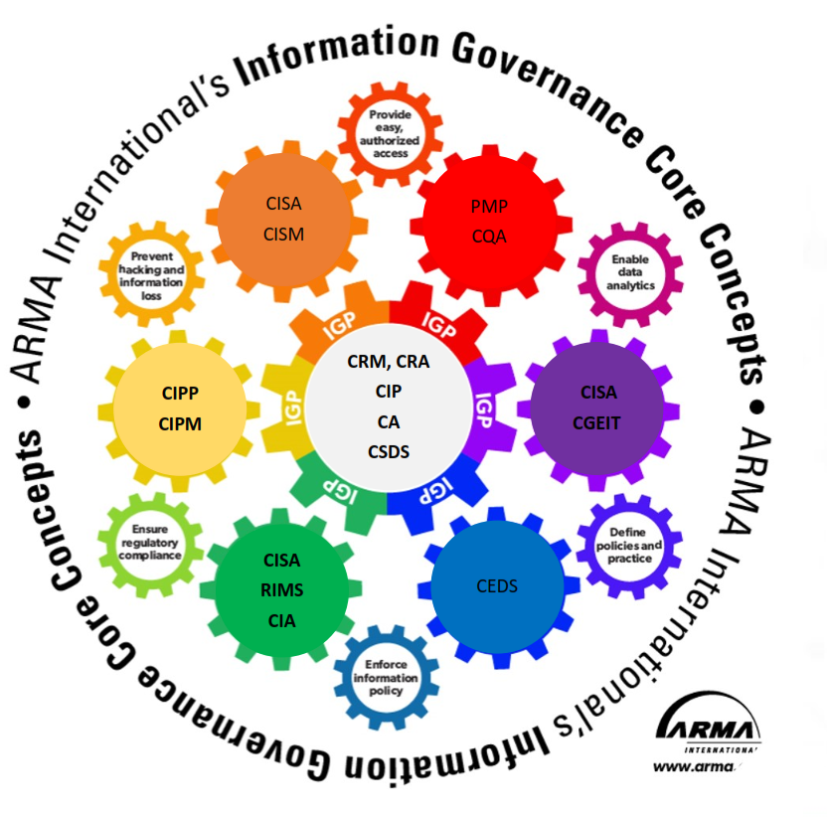
Professional Development – Industry Certifications
IGP
ARMA International
Information Governance
CIPP
IAPP
Privacy
CIP
AIIM
Information Profession
CRM/CRA
ICRM
Records & Information Management

Slide 7
ARMA Charlotte - Piedmont
GDPR After Six Months
November 15, 2018

Slide 8
OVERVIEW
In May, the European Union put into effect a set of regulations that protect the personal data of all E.U. citizens, regardless of the location of the actual storage of the personal data.
Cases – Common Trends
The following are common examples of actions that have triggered actions by Data Protection Data Commissions
Unsolicited Calls / Emails to Consumers - Cases have been for massive phone call / nuisance email distributions
Failure to Protect / Secure Personal Data (Cyber Attacks)
Non Response to Data Subject Requests
"There's so much misinformation out there. I want to be clear that this law is not about fines. It's about putting the consumer and citizen first…. The fine is really a last resort….On the one hand, it has certainly "got the attention of the C-Suite," On the other hand, though, it has given rise to a cottage industry of FUD [fear, uncertainty and doubt] purveyors, vested interests and mischief makers.”- Elizabeth Denham, UK ICO Commissioner

Slide 9
Europe and the GDPR from the Perspective of the Records Manager
Strategy for Addressing GDPR
Identify Personal Data
Understand the Reason for Retaining Data
Under the GDPR, personal data is any information relating to an identified or identifiable natural person (‘data subject’). Areas of focus should be on (1) consumer data, (2) employee data, and (3) potential employee data (i.e., job applicants)
The GDPR recognizes “lawful processing” of personal data for the following reasons: Consent, Contract, Legal Obligation, Vital Interest, Public Interest, and Legitimate Interest.
Dispose of Personal Data When No Longer Needed
Respond to Data Requests
When the purpose for which data was retained is achieved, then the organization should dispose of the data. A few E.U. countries have national laws that specify maximum retention times for certain data – like job applications (UK), employee performance data (France), and consumer contract data (Netherlands). One approach to disposing personal is data is to pseudonymize (removed the personal information) the data.
The GDPR includes the “right to be forgotten.” This requires organizations to disclose and dispose of personal data upon request (unless there is a reason the organization cannot dispose) upon request. This is referred to as a “data subject access request.” The biggest threat to organizations is to not respond to these requests.

Slide 10
The United States Working with the European Union
Transfer – Under E.U. Rules, an organization cannot transfer to third country unless country ensures an adequate level of data protection.
The United States does not meet the Adequate Protection standard, and therefore transferring personal data between the United States and the European Union is illegal, unless additional provisions are taken.
Binding Corporate Rules
Agreements with individual EU Countries
Model Contract Clauses
Individual Contracts with Data Subjects
Privacy Shield
Registration and Voluntary Enforcement from U.S. Dept. of Commerce

Slide 11
The States Respond to the GDPR – But Do Not Duplicate
California Consumer Privacy Act
Important California and GDPR Distinctions
On June 28, 2018, the California legislature signed into law the California Consumer Privacy Act. This law amended the California Civil Code (Sec. 1798), with the intent to ensure the following privacy rights to California residents and citizens by 2020:
(1) The right of Californians to know what personal information is being collected about them.
(2) The right of Californians to know whether their personal information is sold or disclosed and to whom.
(3) The right of Californians to say no to the sale of personal information.
(4) The right of Californians to access their personal information.
(5) The right of Californians to equal service and price, even if they exercise their privacy rights.
While this law has similarities to the European Union General Data Protection Regulation (GDPR), it is not a duplicate of the GDPR.
California law only applies to certain for-profit organizations – with either (1) revenues over $25 Million, has PII of more than 50,000 individuals, and / or more than 50% of its annual revenues from selling consumers’ personal information;
Consent is not required to retain personal data. Instead, consumers have the right to “opt out” of having personal information retained;
No staffing requirements (“data officers”) like the GDPR requires. Although, there is a 45 day requirement to respond to data requests; and
There are fines, but not as excessive as the GDPR - $750 per consumer per incident or actual damages, whichever is greater

Slide 12
Other State Responses
State | Action
Alabama | Finally adopted a data breach law
Arizona | New personal data protection definition, and defined notification timeline
Colorado | Requirement of security policies; oversight of third parties
Iowa | Added securities to protect children online
Louisiana | Requires organizations to take reasonable steps to destroy records with personal information that the business does not intend to retain
Nebraska | Requirement of security policies; oversight of third parties
Oregon | Tighten data breach notification laws
South Carolina | New data protection laws in the insurance industry
South Dakota | Finally adopted a data breach law
Vermont | Regulation of “data brokers,” which also includes registration fee ($100)
Virginia | New requirements for those who prepare income tax returns

