Slide 1
The Citywide open data public records tracker
Cheyenne Flotree
Citywide records program
March 20, 2019

Slide 2
Background
Background
From Lincoln, Nebraska
Bachelor of Arts in History from the University of Nebraska-Lincoln
Master of Science in Library and Information Science (concentration in Archival Studies) from the University of Illinois at Urbana-Champaign
Certified Archivist by the Academy of Certified Archivist

Slide 3
Background
Sheldon Museum of Art – Lincoln, NE

Slide 4
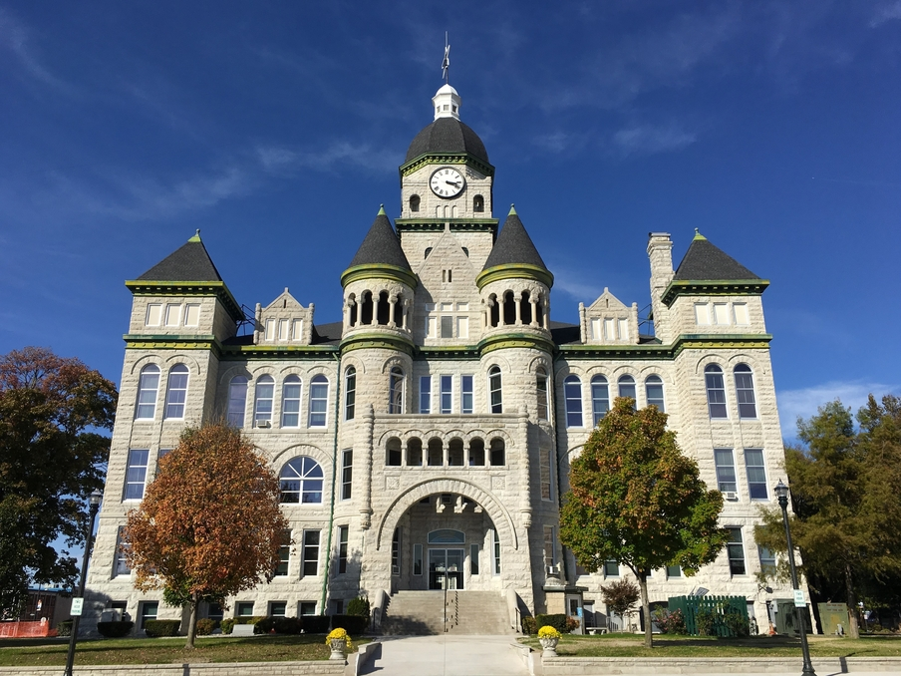
Background
Jasper County – Carthage, MO
Archivist for Jasper County, Missouri
Director of the Jasper County Records Center

Slide 5
Citywide records program
Citywide Records Program – City Clerk’s Office
Records Management
Gaining intellectual control of all the information and records we generate
Know what we have, where it is, how long we need to preserve it
Public Records
Coordinate and centralize public records requests

Slide 6
North Carolina public records law
NC General Statutes Chapter 132 – enacted in 1935
North Carolina has one of the most open public records laws in the US
Affirms public records and public information are property of the people
Very broad definition of what is a public record
Anyone can request a public record for any reason

Slide 7
North Carolina public records law
Purpose of the Law:
Grants greater insight into government
Provides accountability and transparency
Affords the public open access to information
Ensures the preservation of historical records

Slide 8
public records
Information created or received by officials and employees while conducting official City business
Records include all information regardless of physical form

Slide 9
public records Are defined by content
Public Records are designated by:
Content
Function
Format
Device
NOT:

Slide 10
public records
Public Records are:
Papers
Photographs
Videos
Maps
Emails
Voice Mail Messages
Text Messages

Slide 11
What isn’t public record?
Some examples:
Non-Records
Personal messages (spouses, relatives, friends, etc.)
Spam
Protected Records
Employee personnel file information
Personal Identifying Information (social security number, etc.)
Attorney-Client communication
Public enterprise billing information
Criminal investigation records
Sensitive public security information

Slide 12
2018 Requests
2018: 557 Public Records Requests
32% Increase from 2017

Slide 13
Year by year requests (2015-2019)
Total Requests: 1700
2014: 1
2015: 180
2016: 334
2017: 422
2018: 557
2019*: 206
*As of March 21st

Slide 14
Public Records requests Jan-Dec 2018
2018 Total Requests: 557
Average: 2.25 per weekday
Requests By Month
January: 43
February: 38
March: 34
April: 36
May: 38
June: 43
July: 66
August: 41
September: 49
October: 71
November: 60
December: 38

Slide 15
Public Records requests 2019*
2019 Total Requests: 206
Average: 3.5 per weekday
Requests By Month
January: 77
79% increase from 2018
February: 59
55% increase from 2018
March*: 70
105% increase from 2018*
*As of March 21st

Slide 16
The Citywide open data public records tracker
What are our public records goals?
Meeting the public’s information needs
Contributing to open government and transparency
How can we continue to achieve this?
Improve and create internal processes
Educate employees/officials about public records
Create an external public records tracker

Slide 17
Internal-External tracker
We developed our own public records tracker
Collaboration
The City Clerk’s Office – Citywide Records Program
The Office of Data & Analytics – Data Co-Lab
Charlotte Communications & Marketing
Part of the new Charlotte Open Data Portal
Takes our internal public records tracker and makes it external
Notes:
-

Slide 18
The Citywide open data public records tracker

Slide 19
Sunshine day 2019 launch
The Open Data Portal Public Records Tracker
Launch date is March 11, 2019 (Sunshine Day)

Slide 20
The Citywide open data public records tracker

Slide 21
Tracker Fields
We will be providing the fields that provide the most relevant information
Request ID #
Date Received
Name of Requestor
Organization of Requestor
Records Requested
Assigned Department
Process Stage
Date Fulfilled/Closed
Media
Download Link (if the information can be shared)

Slide 22
Next step
How will we improve it in the future?
The next step involves sharing public records materials on this tracker
Records request materials deemed fully public will be open for all
Technology in place – still need to develop the internal process
Introduced over the coming weeks and months

Slide 23
Thank you
Questions?

