Slide 1

Office 365 Overview
(What the RIM / IG Professional Needs to Know)
Laurie Fischer, CRM, CIPM
February 21, 2019

Slide 2
Agenda
Today’s Information Management Challenges
Overview of O365
  Primary Content Management Elements
  Security + Compliance Center

Slide 3
Today’s Information Management Challenges

Slide 4
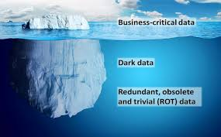
Yesterday / Today
Email and shared drives are used for collaboration and sharing
End-users store unstructured content on shared drives and in email systems
Email and shared drives were never meant to be recordkeeping systems
  Lack of records management functionality for retention, disposition, preservation, shared access, etc.
  No distinction between business records
  and redundant, obsolete or trivial
  information
This has resulted in:
  Unencumbered growth of information
  A huge unorganized mess!

Slide 5
Today / Tomorrow
Office 365 provides much improved methods for collaboration
Natively, still not a recordkeeping system
With volumes increasing and more / larger file types and sizes, the data proliferation challenge of today will be magnified multi-fold in the future
  Many more places to create and retain
  files and documents in O365

Slide 6
Issues / Risks
Without proper guidance and governance within O365, the lack of content controls and mismanagement will continue
Due to the familiarity and supposed simplicity of a solution such as O365 (Exchange, SharePoint, etc.), IT often “introduces” O365 simply as an upgrade
Office 365 is an enterprise solution and should be treated as such
  Treat every application within O365 as a stand-alone enterprise solution and force it through the same rigors ( i.e. the SDLC process and in-depth reviews from security, privacy and compliance) that are required for other applications
  Establish appropriate governance for both the technical implementation and the content management aspect of the O365 ecosystem

Slide 7

If we don’t…

Slide 8
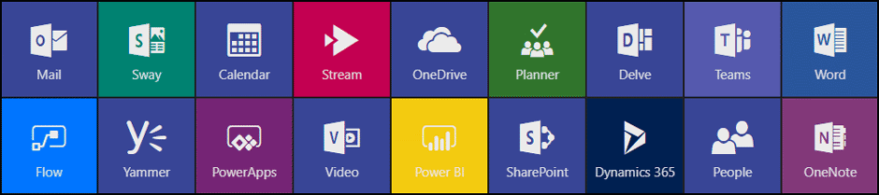
Critical Success Factor:
Content Placement Strategy
Ensures that the right tool is being used for the right job
  Includes integrating existing solutions (such as DM / ECM) to leverage higher-level records management functionality
Guidance / best practices / requirements for what type of content should be stored in which O365 solution so that it can be managed through its lifecycle efficiently and effectively

Slide 9
Content Placement Strategy Guidelines
Takes each application’s strengths and weaknesses into consideration
Defines the type of content that can be stored in each application
Must consider the need to move content between repositories as the content changes over time (e.g. migrating records from email to a more appropriate recordkeeping system such as SharePoint)
Where | Whose is it? | Usage
Email | Mixed | Short-term retention of correspondence Alerts, Correspondence, Personal Admin
Teams | Ours | Chat-enabled group with document / content collaboration features Projects, Departments, Topical (Event-Planning Committee)
SharePoint Records Repository(ies) | The Company’s | Metadata-Driven Libraries Retention Based on Library, Label, Content Type Edit Access tightly-controlled
OneDrive for Business | Mine | Replaces Personal Drive and Local Drive Employee-controlled sharing of content (internal and external) Drafts, Reference, Personal Admin (Expenses, Performance)

Slide 10
O365 Overview
Content Placement Elements

Slide 11
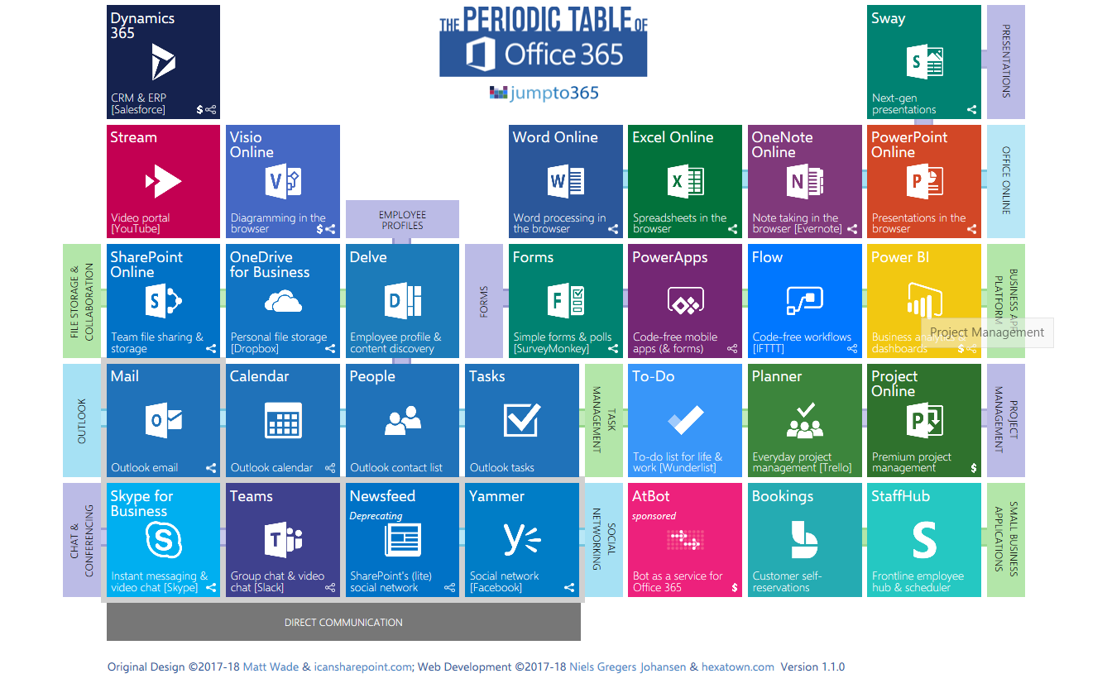
O365 Ecosystem

Slide 12
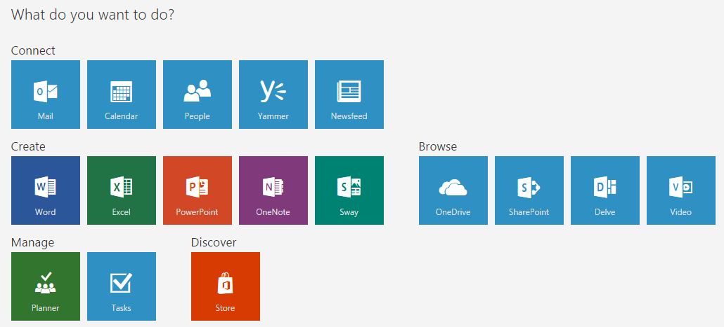

What do you do with it?

Slide 13
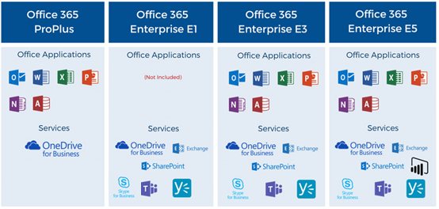
Enterprise License Options
Clients
OD4B
Online Only
Clients +
Online
Clients + Online + BI +
Governance
Notes:
All

Slide 14
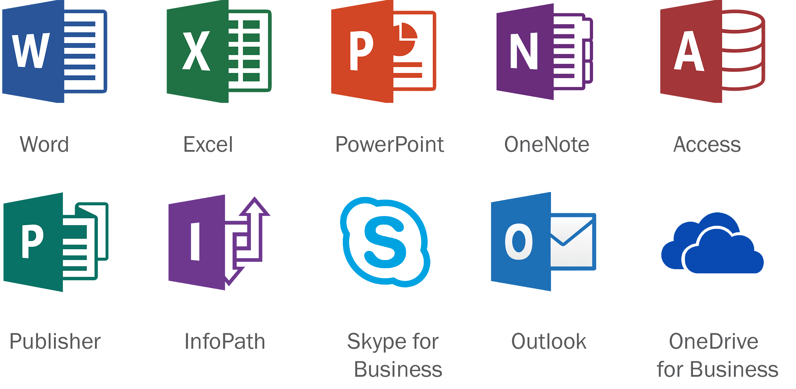
Office Applications
As a subscription service, O365 also offers the latest versions of the common Office desktop applications.

Slide 15
Key Content Management Elements
Content Storage and Management
  Primary Applications
    Exchange Online
    OneDrive for Business
    SharePoint Online
  Can provide content storage and management according to the organization’s policies for retention, disposition, preservation, protection, etc.
  SharePoint is the primary location for all O365 content

Slide 16
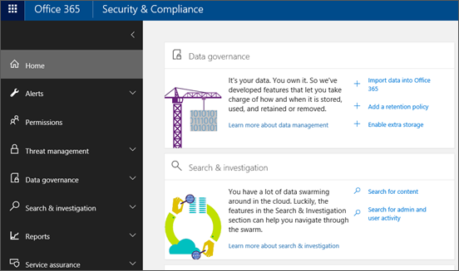
Content Governance
Security & Compliance Center
  Primary tool for protecting and controlling an organization’s data
  Manages compliance for data across the Office 365 ecosystem
  Enables content retention (automatic or user driven) using O365 Retention Labels
  Manages eDiscovery searches and holds
  Allows for auditing and metrics

Slide 17
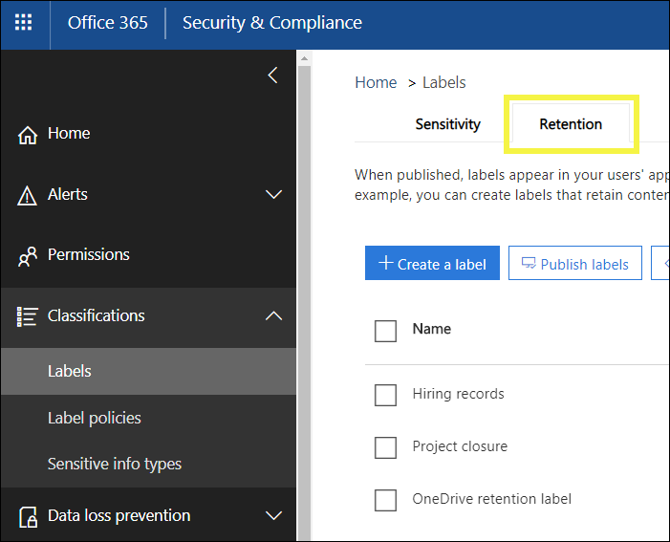
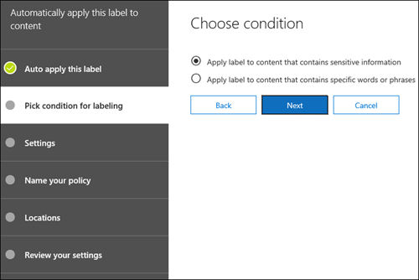
O365 Retention Labels
Allows simple, cross-service tagging to flag documents, to declare as a record, or for other actions such as DLP
Applying a label, such as “Invoice”, can trigger retention by create date, modified date or date the label was applied
Can be used across applications such as Exchange email, Office 365 groups, OneDrive and SharePoint or specific services and locations

Slide 18
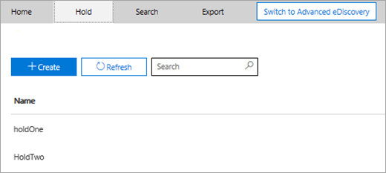
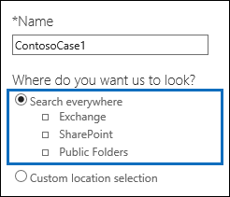
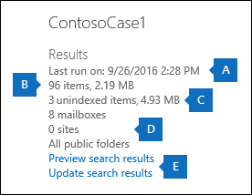
O365 eDiscovery
O365’s eDiscovery functionality searches for relevant content in Exchange Online mailboxes, Groups, Teams, SharePoint Online and OneDrive for Business sites, and Skype conversations
eDiscovery cases in the Security & Compliance Center can be used to identify, hold, and export content found in mailboxes and sites
With the E5 subscription, an organization can further analyze content using Office 365 Advanced eDiscovery

Slide 19
O365 Key Components

Slide 20
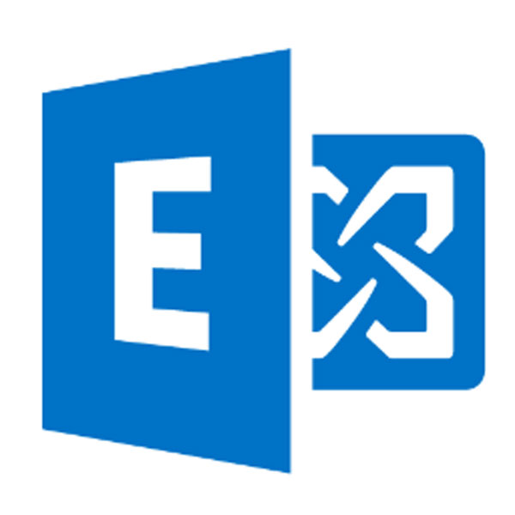
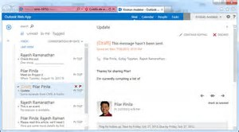
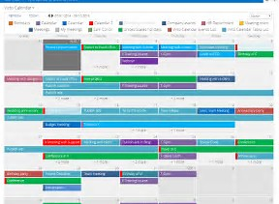
Exchange
What is it?
  It’s email, but also:
    Calendars
    Contacts
    Scheduling
    Notes
    Tasks

Slide 21
Exchange
How is it used?
    Outlook
    Employee/group mailboxes and calendars
    Store and sync contacts and notes
    Repository for documents and CYA
Trends:
  Decreased usage of:
    Email as an ad-hoc workflow system
    Email as the sole communication tool
    File collaboration via email attachments

Slide 22

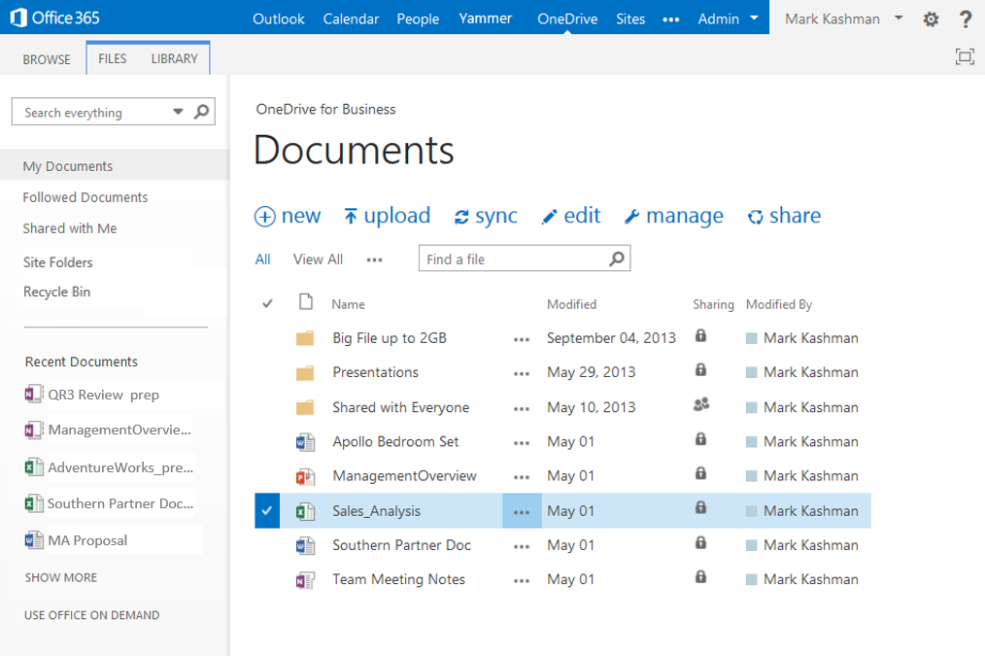
OneDrive for Business
What is it?
  Microsoft’s answer to Box, Dropbox, etc.
  Replacement for personal drives
  Unlimited Storage for E3 + E5 licenses

Slide 23
OneDrive for Business
What does it do?
  Enterprise File Sync and Share
  Synchronization of files between the desktop and the cloud (OneDrive files/folders and SharePoint Libraries)
  Easy sharing of documents and folders
  Single-source collaboration, co-authoring

Slide 24
OneDrive for Business
Trends:
  Replacement of file shares, especially personal drives
  Fastest growing storage solution
  Reduction of unauthorized installs of EFSS software
    “Shadow IT”

Slide 25
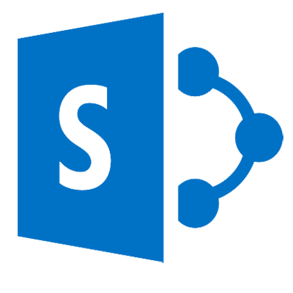
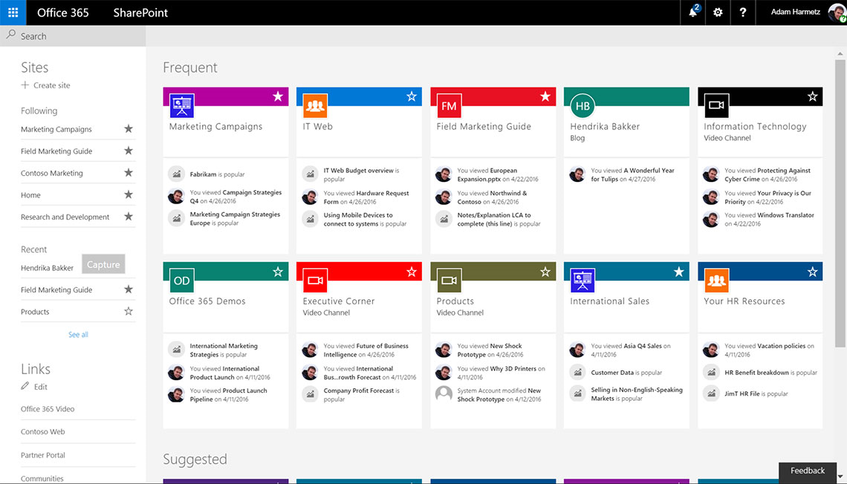
SharePoint
What is it?
  Share and manage content, knowledge, and applications to empower teamwork, quickly find information, and seamlessly collaborate across the organization. - Microsoft

Slide 26
SharePoint
What else does it do?
  WCM: Intranet, public websites
  Enterprise social network
  Collaboration
  Search
  Workflow
  Forms
  Content Sharing
  A platform: custom applications
  ECM / DM / Content Management
    Libraries
    Versioning
    Content Types
    Metadata
    Security
    Workflow
    Search

Slide 27

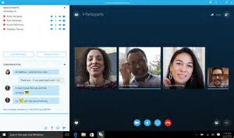
Skype for Business
What is it?
    Instant messaging
    Audio and video calling
    Online meetings
    Web conferencing capabilities

Slide 28

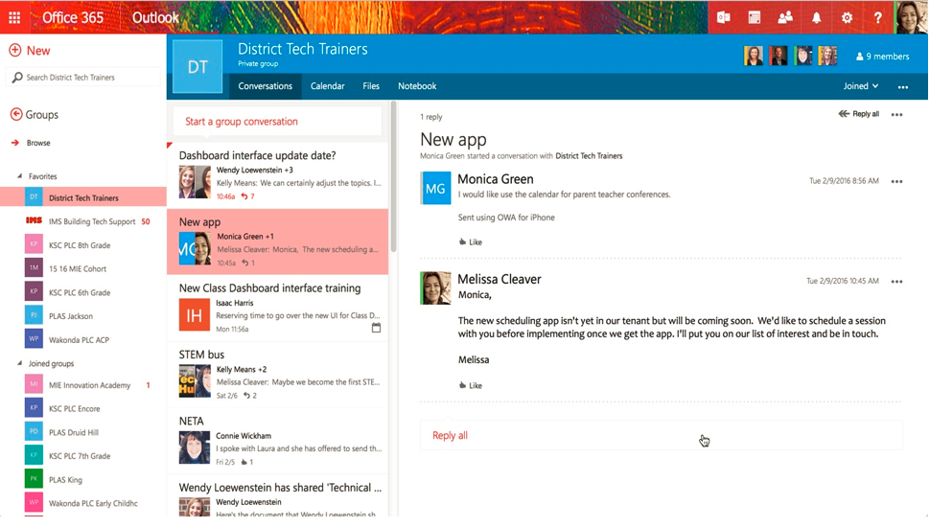
Groups
What is it?
  Think of it as a group of O365 applications setup around a group of people:
    Shared Inbox
    Shared Calendar
    SharePoint Document Library
    Shared OneNote Notebook
    SharePoint Team Site
    Planner
  Easy provisioning = Sprawl and Oversharing

Slide 29
Teams
What does it do?
  Chat-based workspace leveraged by employees and teams who are looking to collaborate in real-time with the same group of people
  Hub for collaboration
  Brings together the capabilities of Office 365 (Word, Excel, PowerPoint, SharePoint, OneNote, etc.)
Trends:
  Rapid Adoption
  Replacing email as the primary form of communication

Slide 30

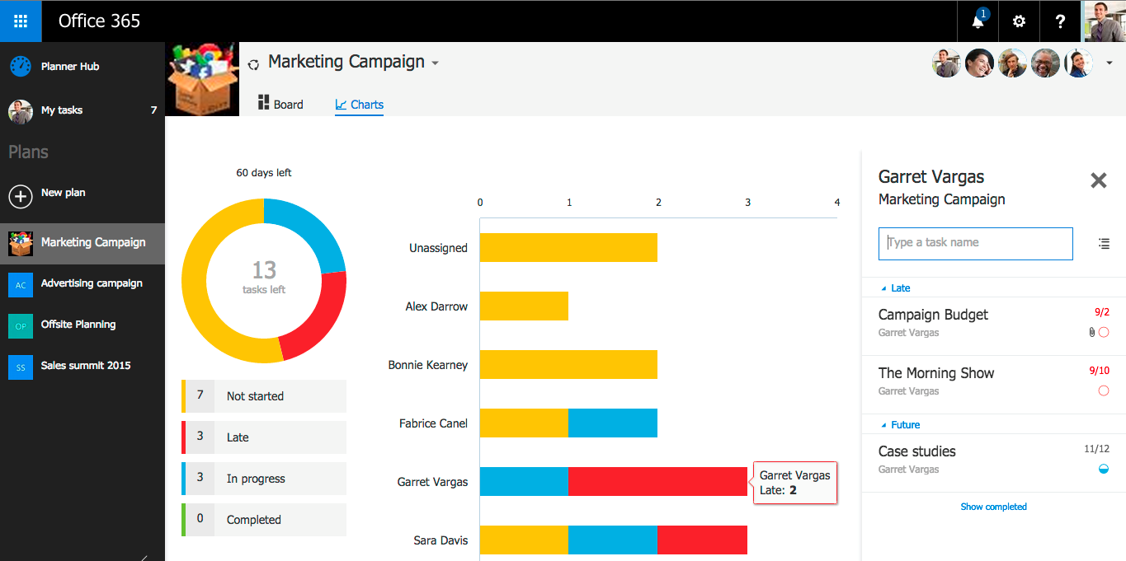
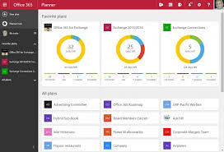
Planner
What is it?
  Project management light solution
  Used for medium-weight project planning
  Easy learning curve for new users
  Visual task board to update assignments or status via drag and drop

Slide 31

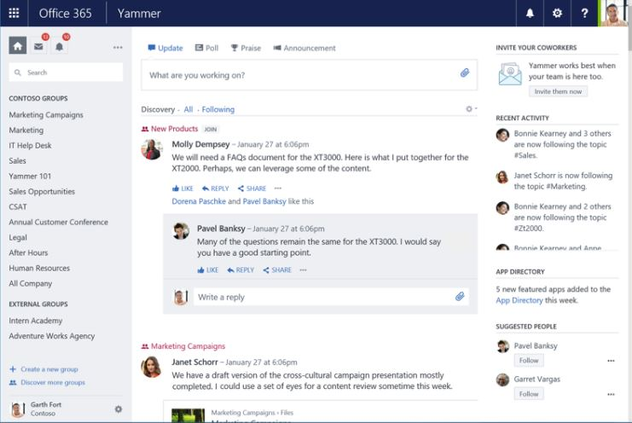
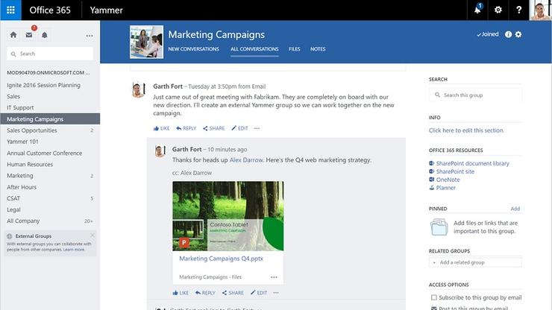
Yammer
What does it do?
  Acts as an internal social network
  Discussion teams can set up meeting appointments using Outlook, switch to a full-fledged Skype video meeting, and access OneDrive to create shared documents
  Makes suggestions (“you may be interested in this post”)

Slide 32
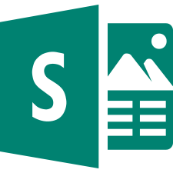
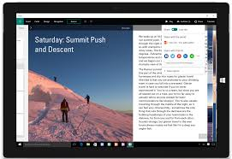
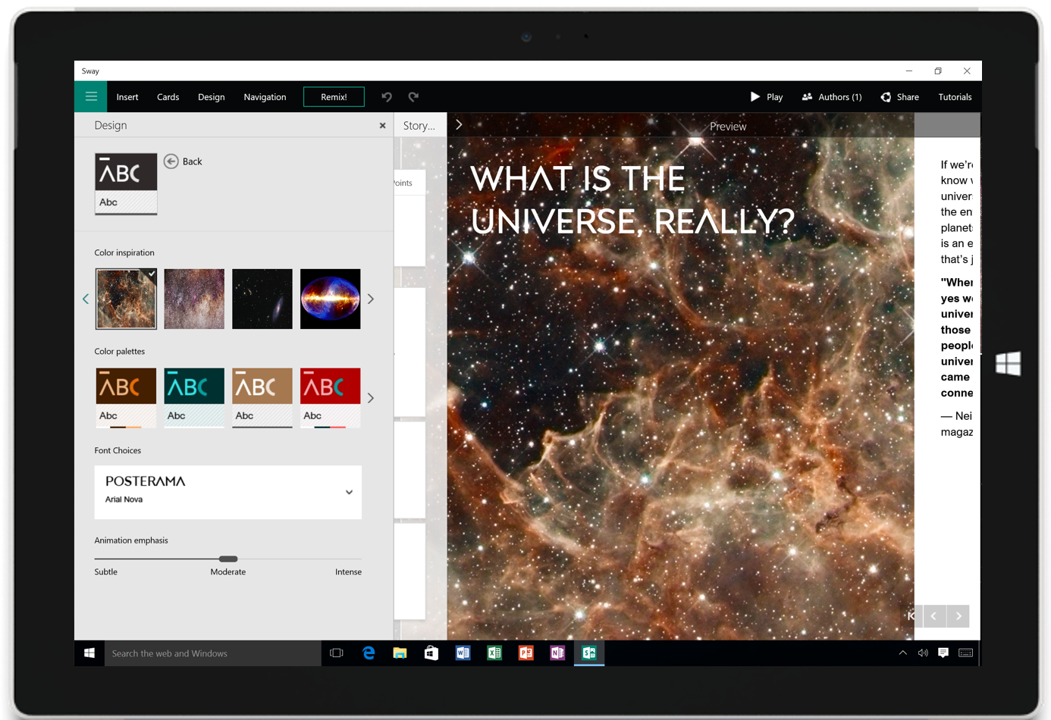
Sway
What is it?
  Creates presentations
  No, it’s not PowerPoint
    PowerPoint is intended for audiences and driven by a presenter
    Sway is more interactive and web-based
  Used more heavily in education

Slide 33

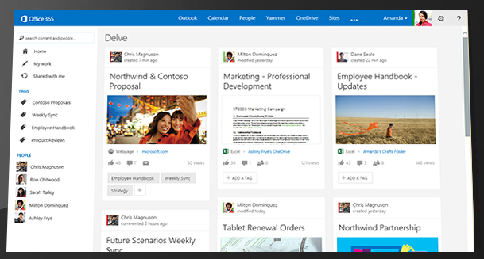
Delve
What is it?
  Big Data analytics focused on content and connections within an organization
  A dashboard of likely relevant content
  Ordered by relevance
  Monitors activity and connections to derive relevance
  With Delve, information finds you versus you having to find information

Slide 34
Final Thoughts

Slide 35
O365 Key Considerations:
Governance Program
It Takes a Village:
  Establish Roles & Responsibilities (IT, Legal, Compliance, Security/Privacy, etc.)
End-user focus groups
Develop a governance framework
Resource:
  Summary Table listing primary O365 applications (Handout)

Slide 36
Develop Policies and Procedures
Implementation of O365 should be packaged with policies to ensure roles, responsibilities and usage are understood.
Resource:
  Recommended Policies - suggested policies to have available prior to the roll out of O365, as well as key components of each policy (Handout)

Slide 37
From here to there…
O365 Governance and Content Placement Strategy
Unstructured Data Optimization and Migration Strategy
Change Management

Slide 39
Records Management / Information Governance
HBR Consulting provides expert assistance in the development of sound information governance strategies and “actionable” implementation plans that enhance legal and regulatory compliance, lower eDiscovery and storage costs, protect and secure sensitive data, and foster productivity and collaboration. Our comprehensive approach enables us to deliver end-to-end solutions that consider information governance needs, enabling technologies and business process improvements.
Information
Governance
Information governance diagnostic assessments and analyses, including strategy and implementation plans designed to achieve measurable results within realistic timeframes.
GDPR compliance and privacy assessments, program recommendations, data classification standards, data maps and data flows, privacy policies, and training, all with the objective of helping protect and secure an organization’s most sensitive and critical data.
Evaluation, development, updating and globalization of records retention schedules using our extensive domestic and international regulatory research capabilities.
Office 365 governance strategies, including detailed plans for the deployment of O365 features for content management, collaboration and compliance.
Enterprise content management strategies, implementation plans, road maps and detailed project plans.
Email management strategies, process improvements and enabling technology tools.
Technology assessments: Evaluation, selection and guidance on a variety of applications, systems and platforms that support the lifecycle management of records and information, regardless of media.
Data remediation and defensible disposition strategies.
Change management services for deploying change into the organization’s business processes and systems.

